Slide 1

Render
Render Lab Room
Antoine
Vincent
Not actual in-engine footage

Slide 2


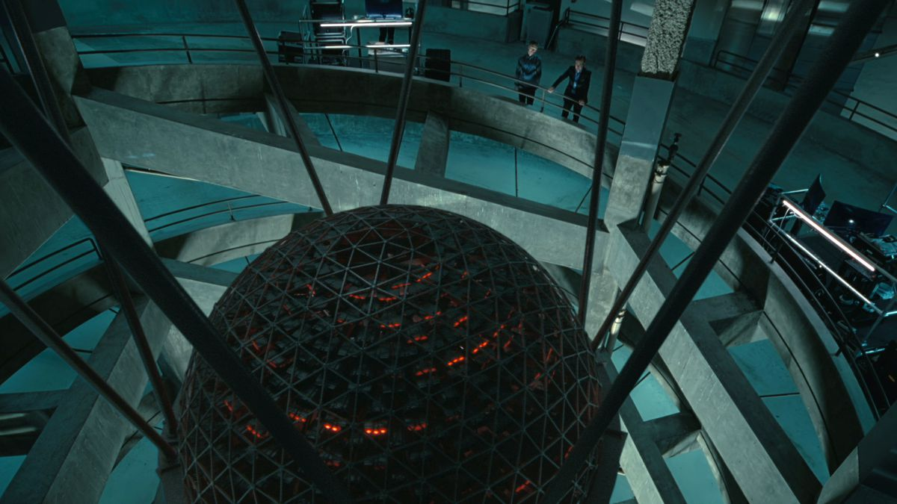
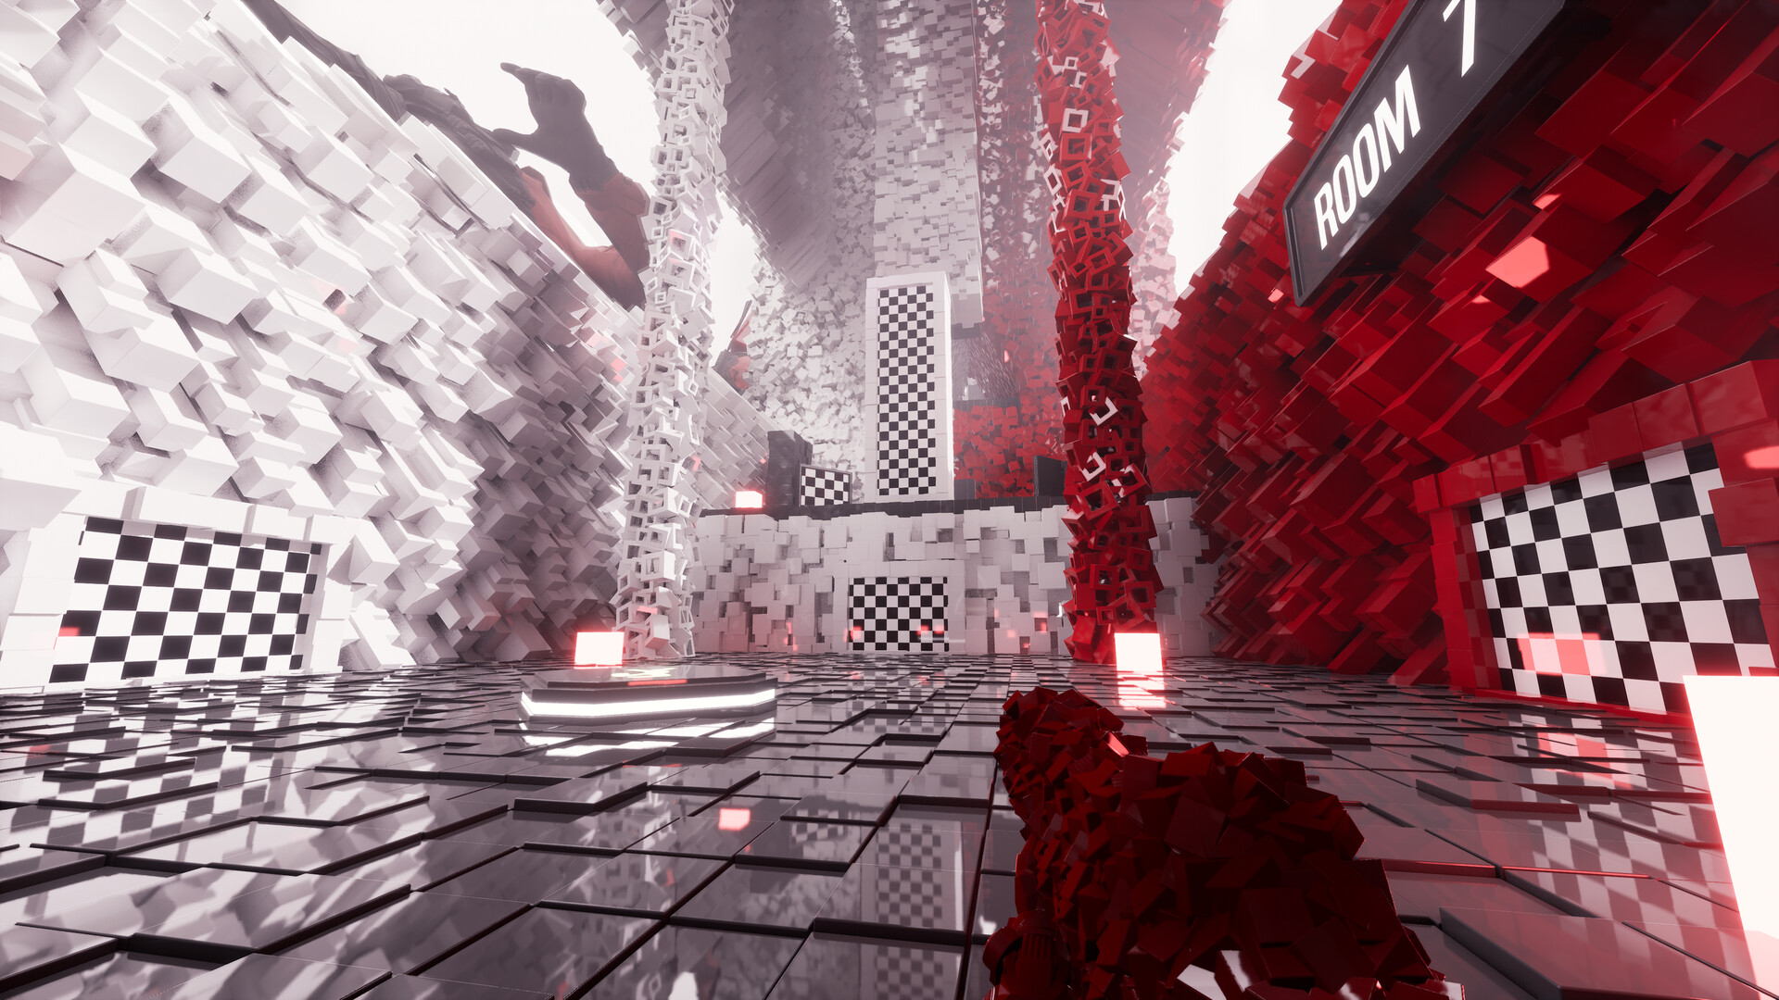
Inspiration

Slide 3

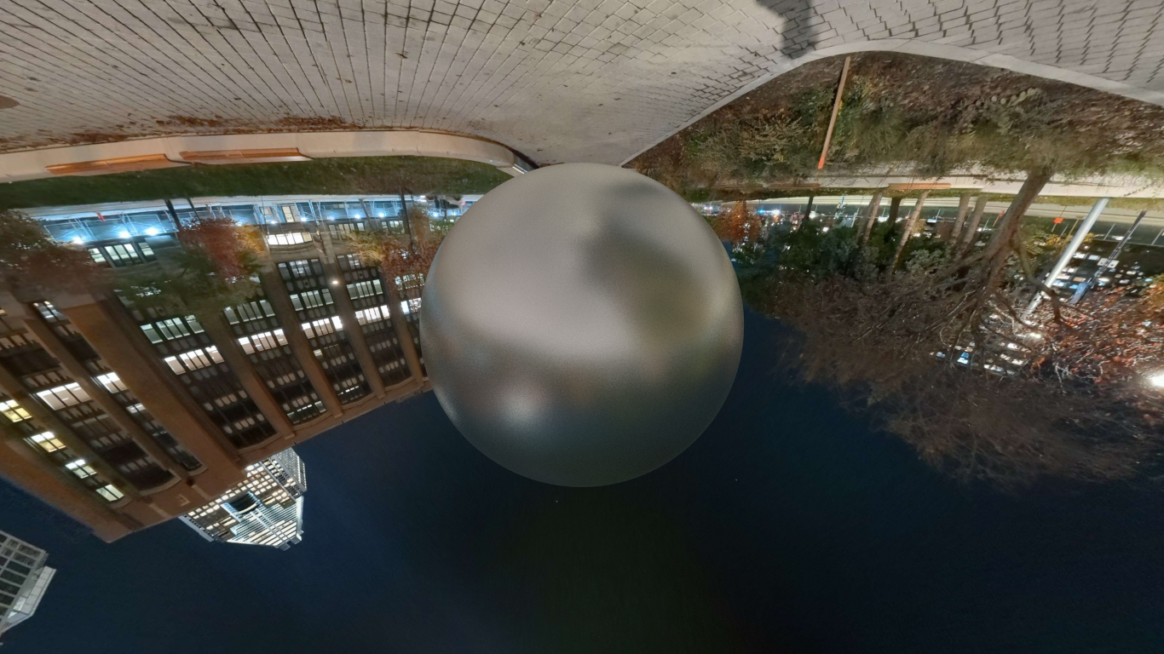
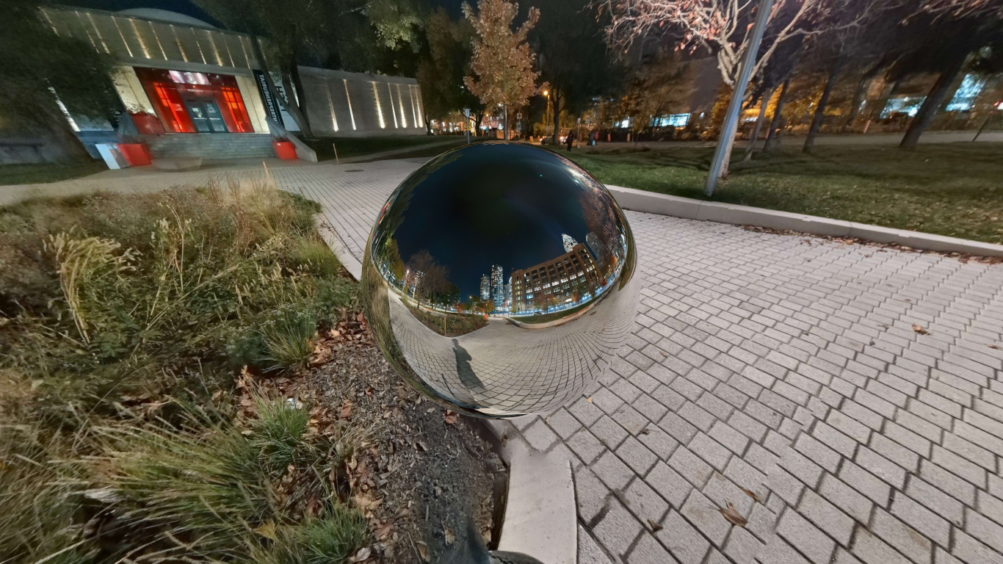
Skybox

Slide 4
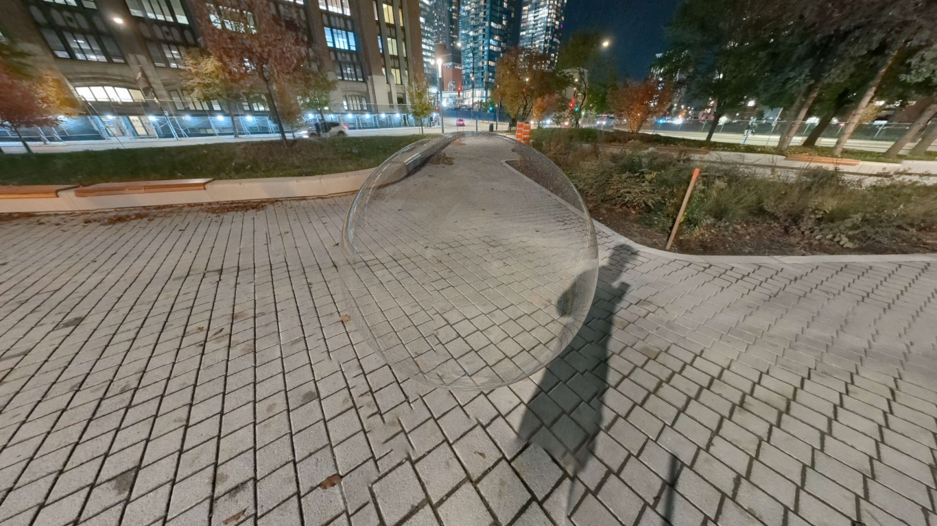
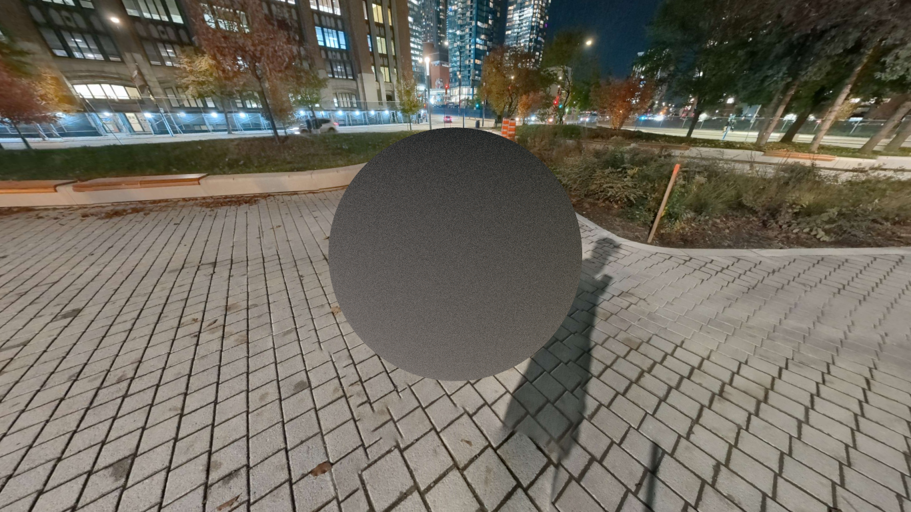
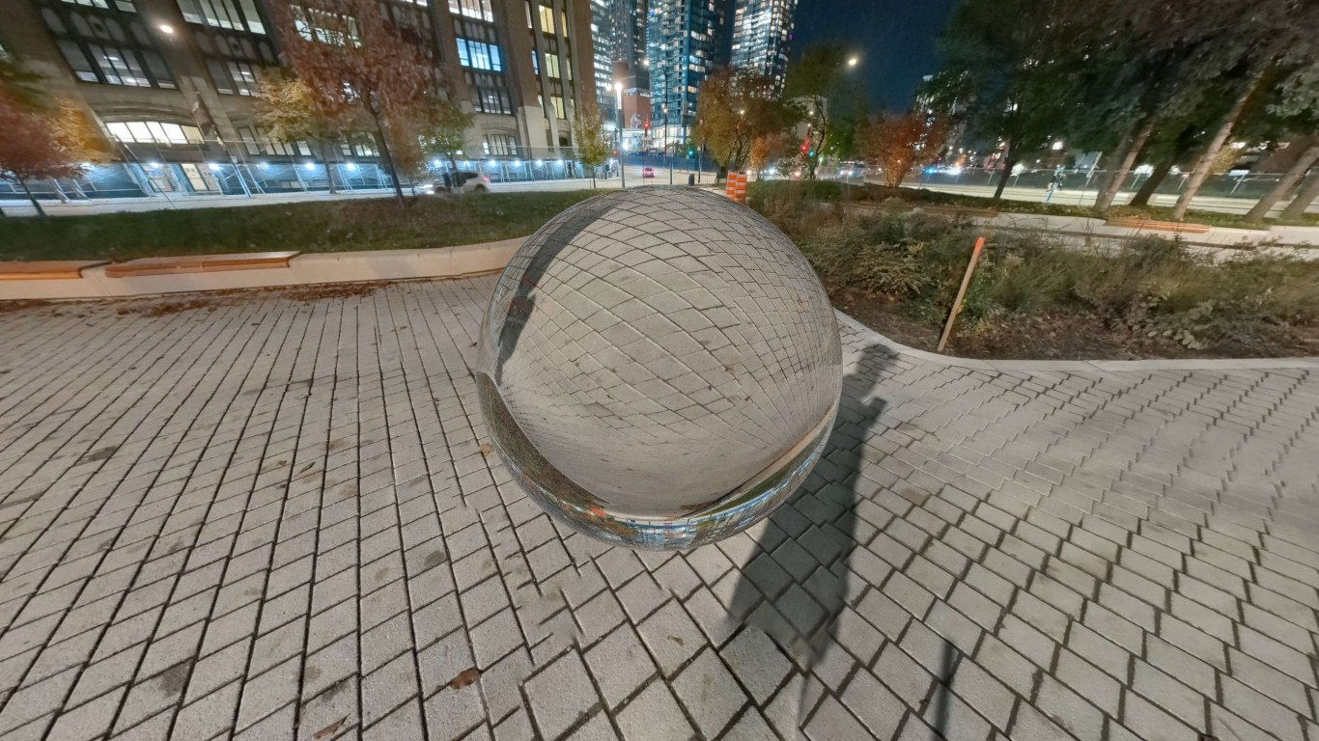
Tests with different materials
Thin dielectric
Rough Conductor
Diffuse
Dielectric
Metal

Slide 5
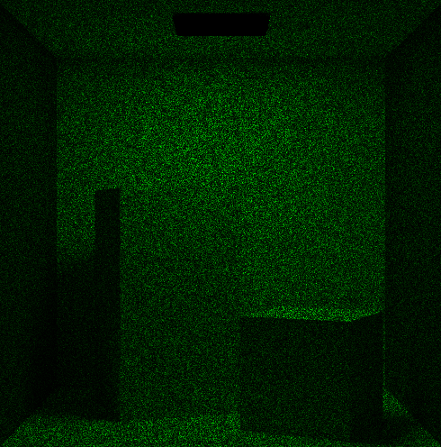
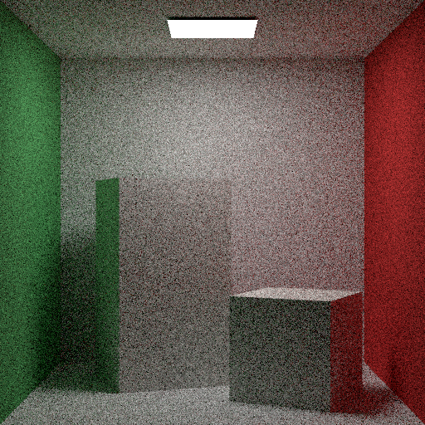
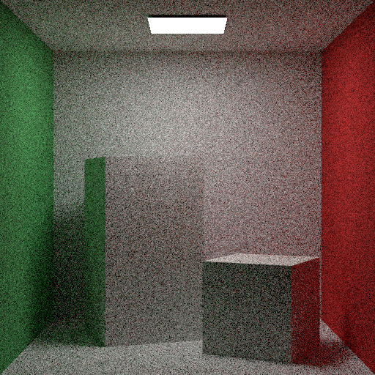
Scattering Sampling

Slide 6

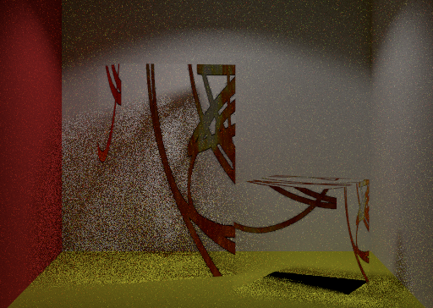
Alpha material

Slide 7
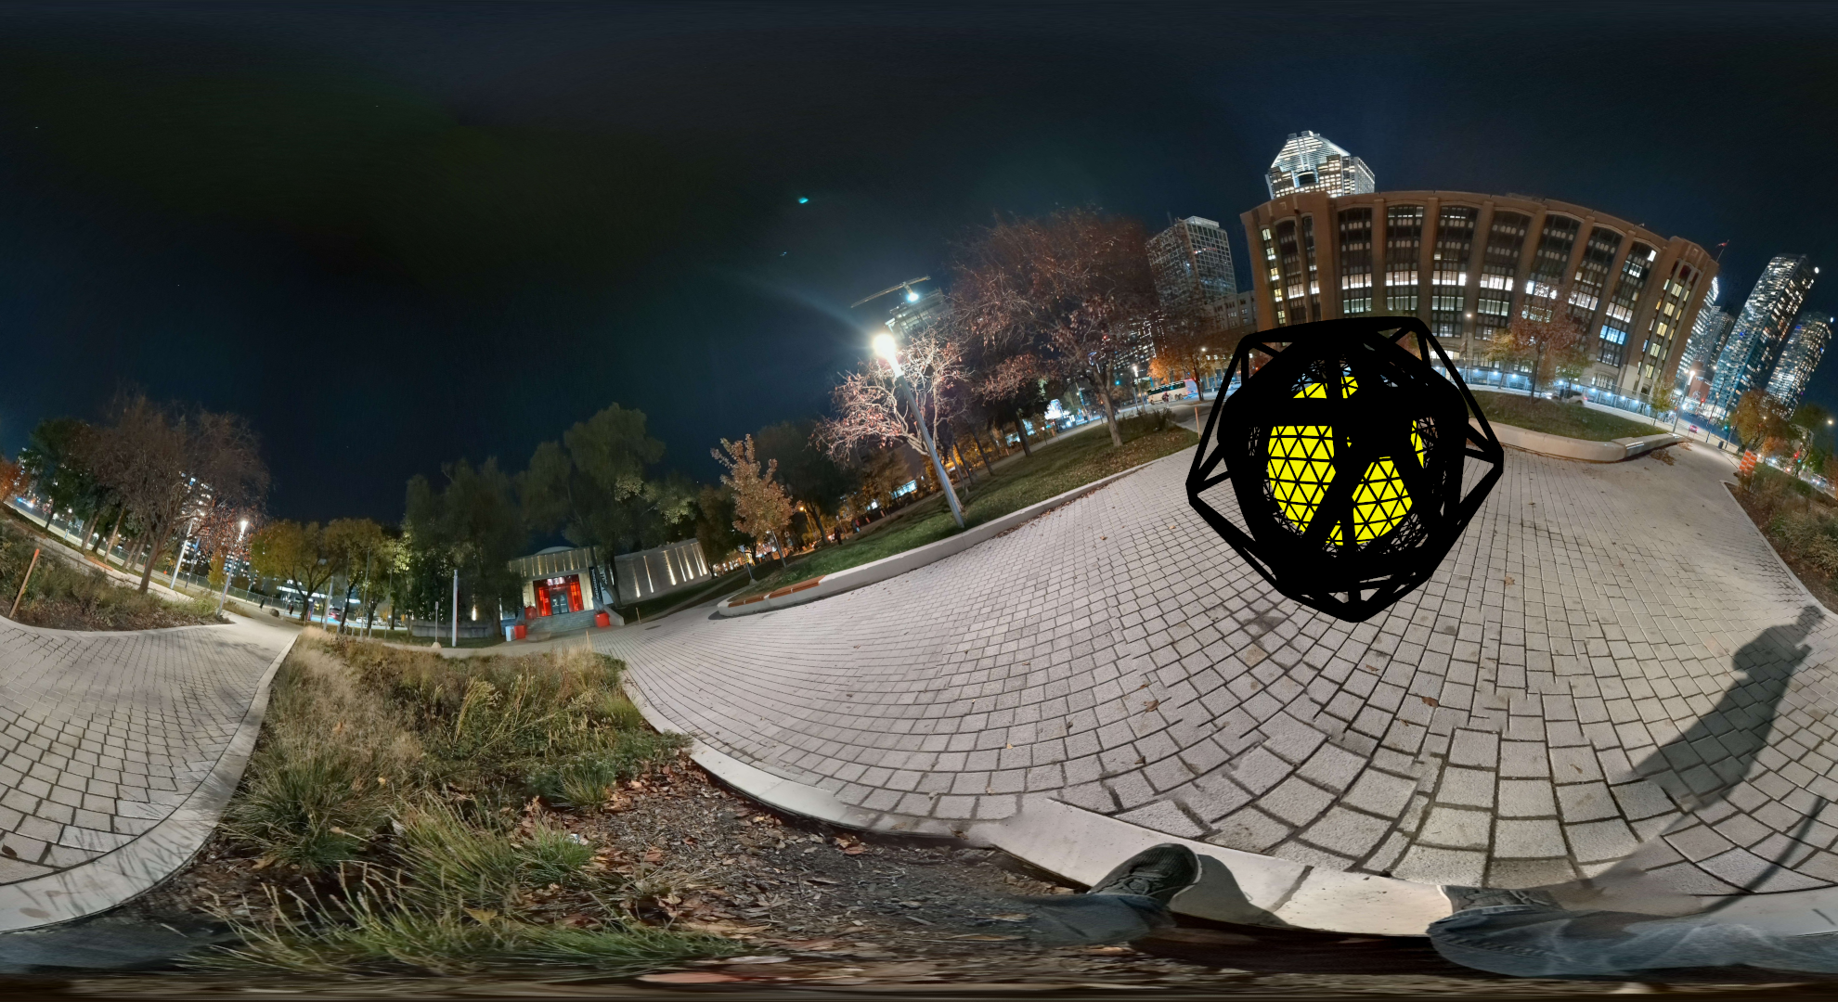
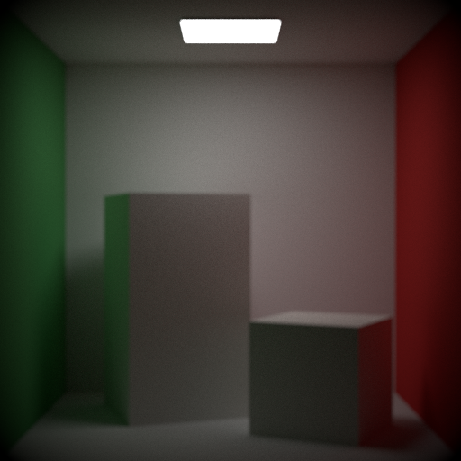
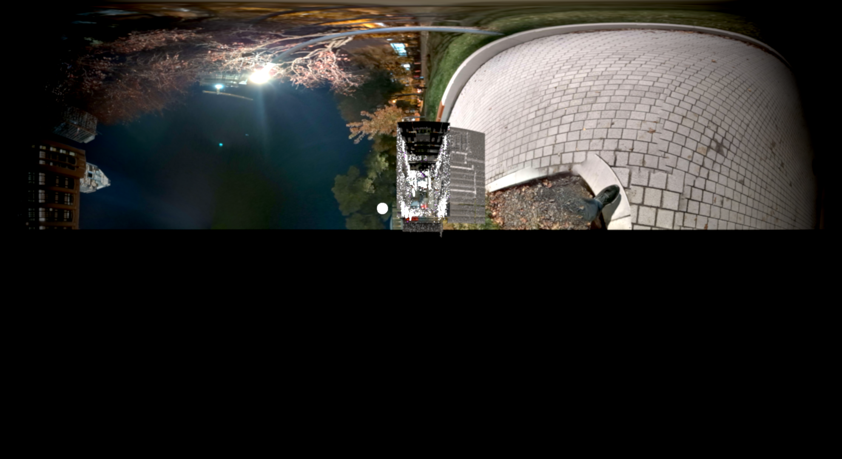
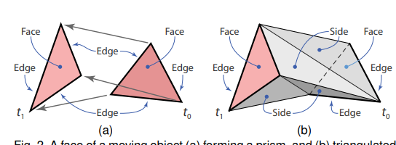
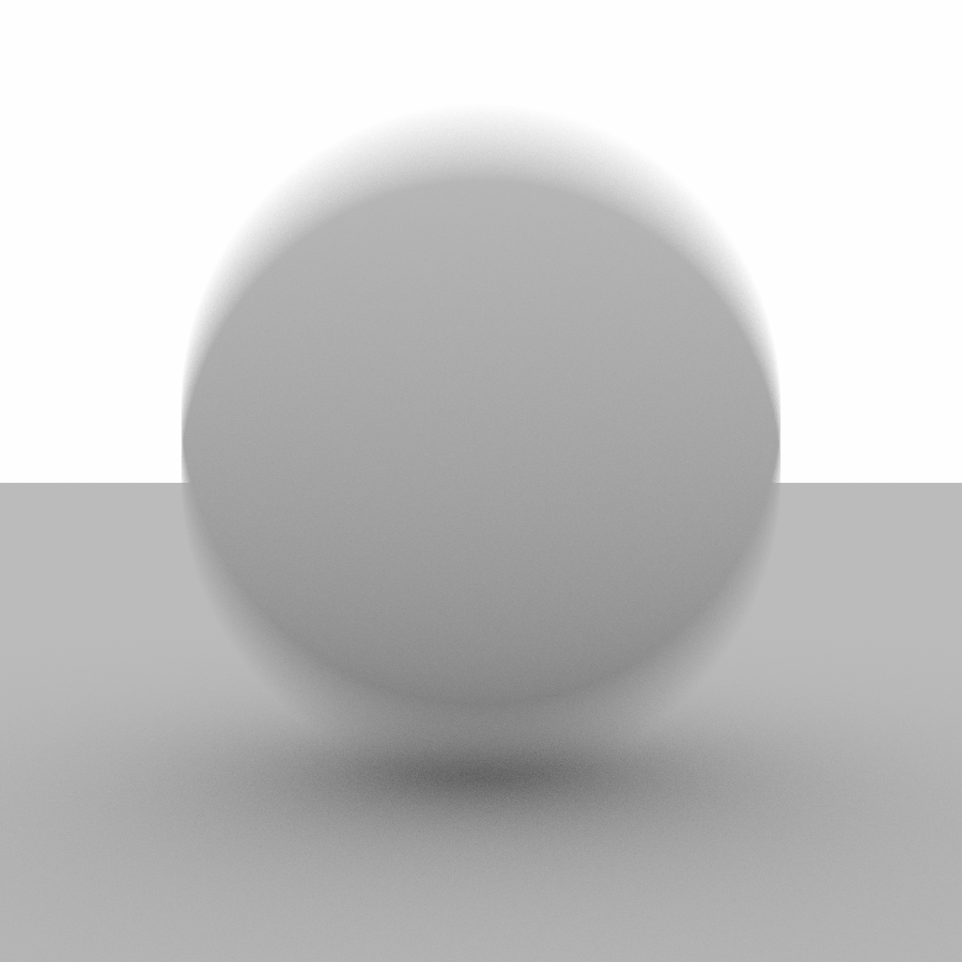
Camera Focus Motion Blur

Slide 8
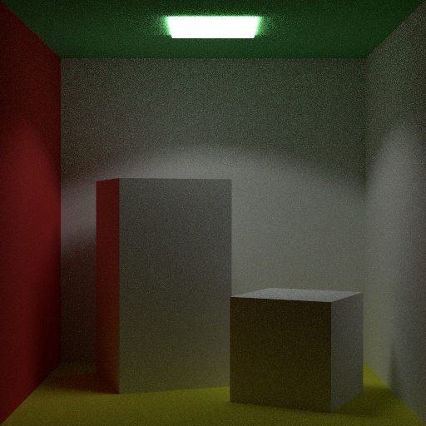
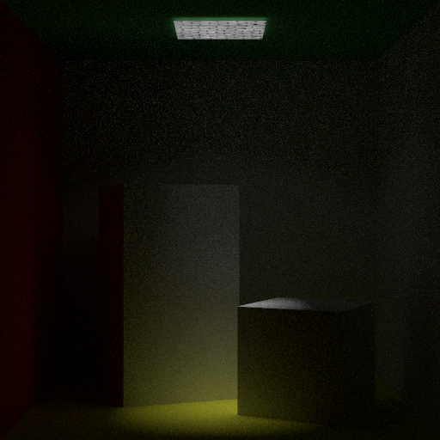
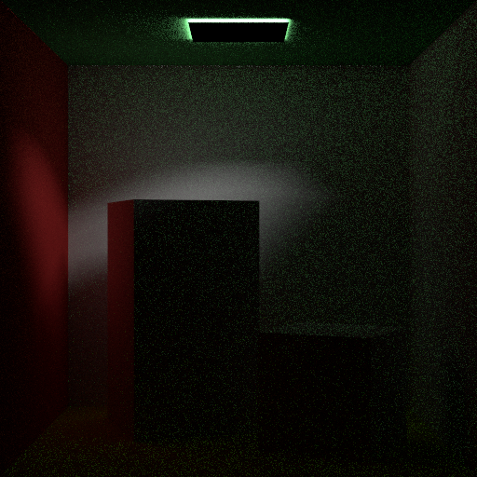
Point Light

Slide 9
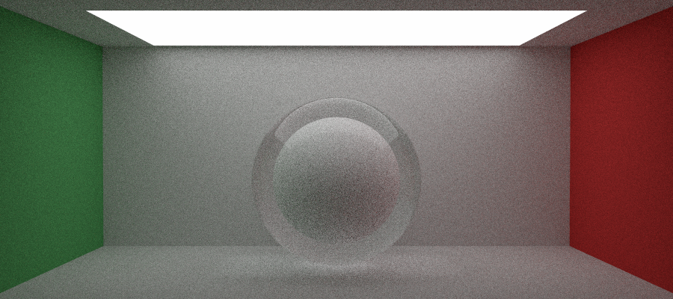
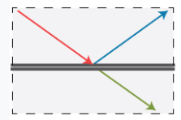
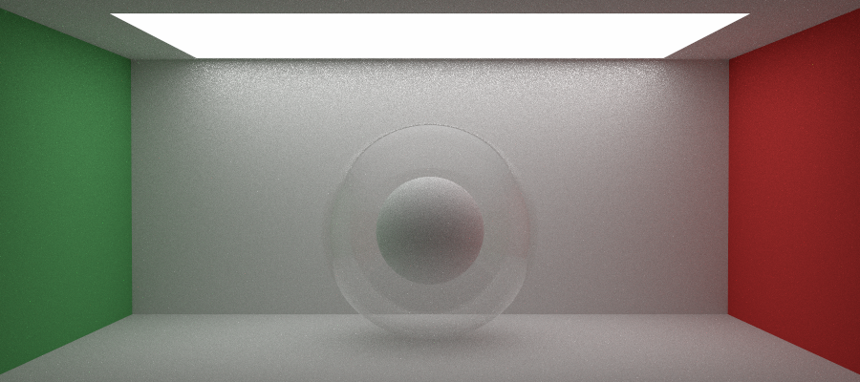
Thin Dielectric
Dielectric (top) vs Thin_Dielectric (bottom)

Slide 10
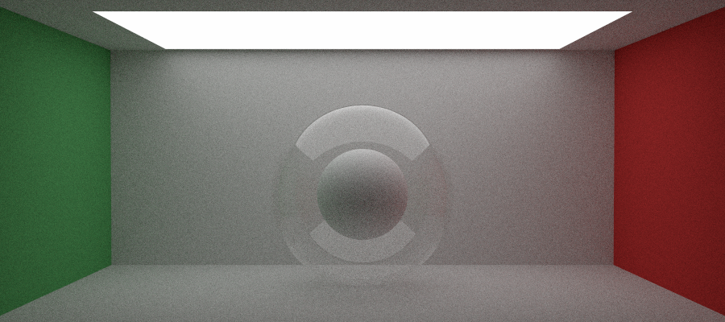
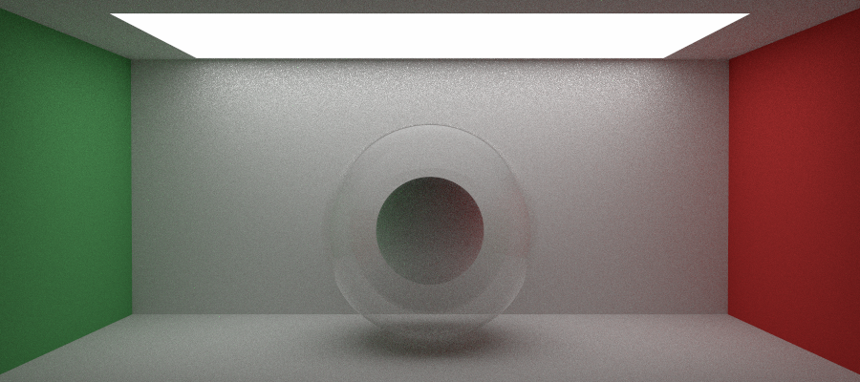
Thin Dielectric - Trick
Classic path tracer
MIS path tracer + ignore visibility
MIS path tracer

Slide 11
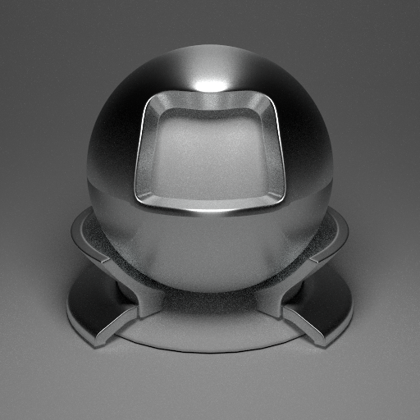
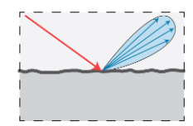
Rough Conductor

Slide 12
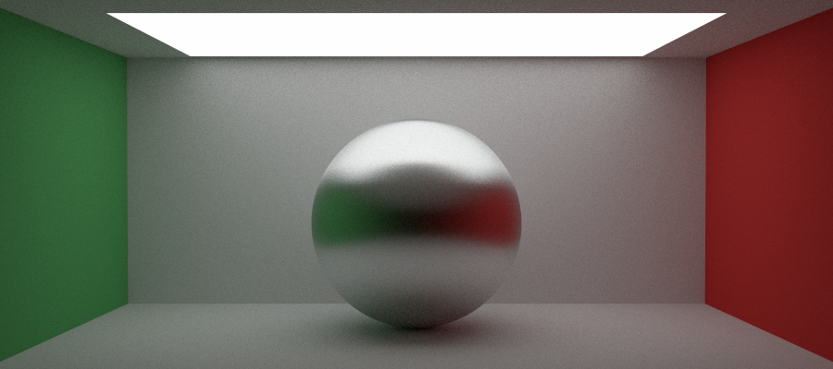
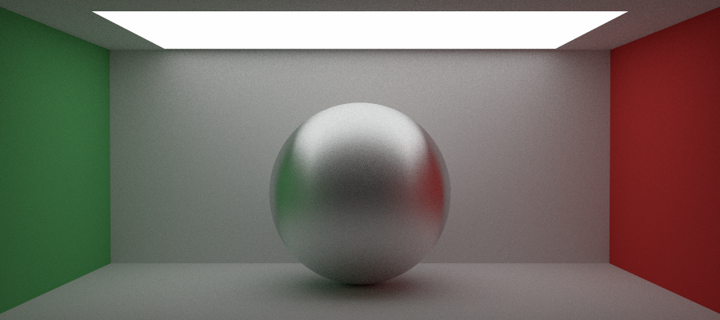
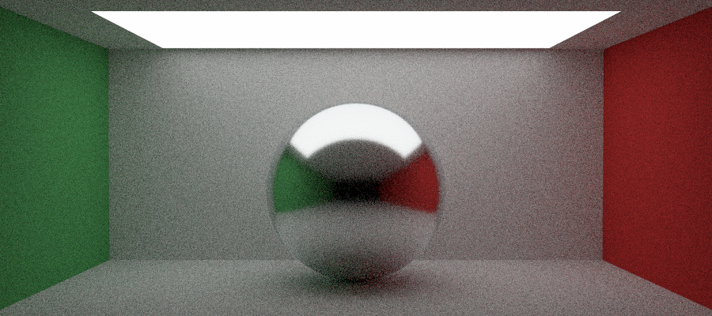
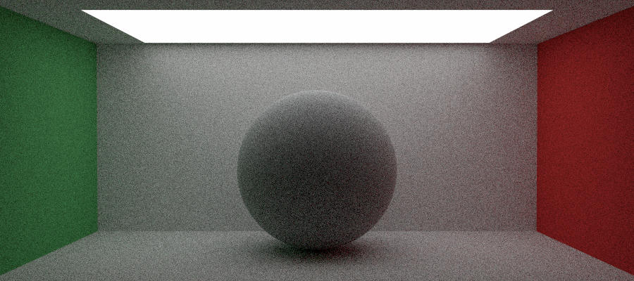
Anisotropic
AlphaX = 0.3 , alphaY = 0.05
AlphaX = 0.05 , alphaY = 0.3
Alpha = 0.05
Alpha = 1.0
Isotropic

Slide 13
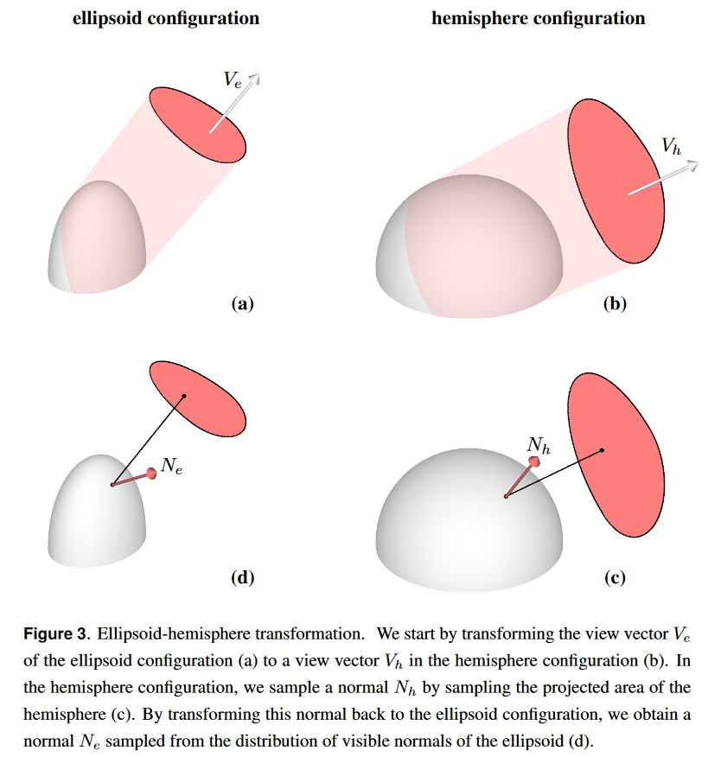
Microfacet model
https://jcgt.org/published/0007/04/01/paper.pdf
Intermediary class
Goal = sample microfacet normal to simplify sampling of materials themselves
Advantage = easier to implement other rough materials (rough plastic...)

Slide 14
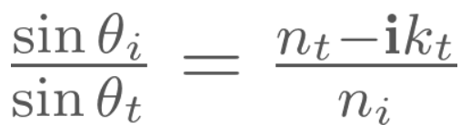
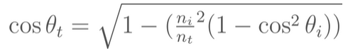
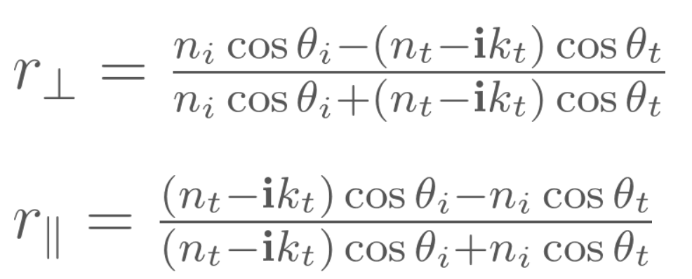
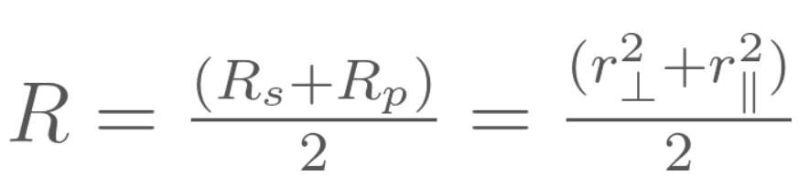
Complex value (Rough conductor)
To get the right rendering for physically accurate conductors, we pass eta as a complex value comprised of eta_t (Real part) and k (Imaginary part) to our material.
-> Necessary to modify fresnel calculations :
For the interface between two dielectric materials, k_{t}= 0
Source : https://seblagarde.wordpress.com/2013/04/29/memo-on-fresnel-equations/

Slide 15




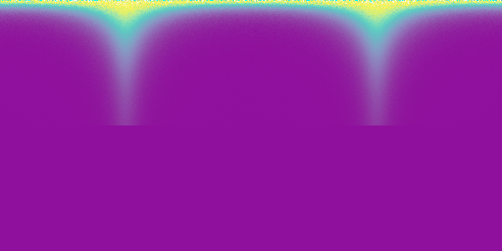




PDF
HIST
DIFF
45 degree
0 degree
87 degree

Slide 16
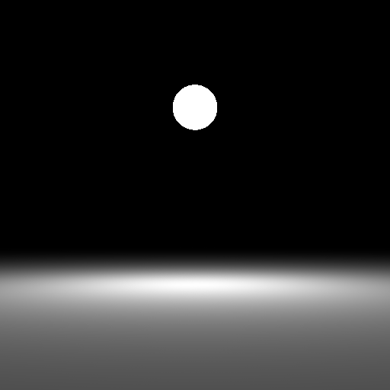
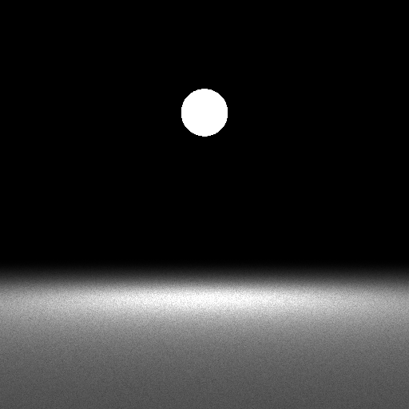
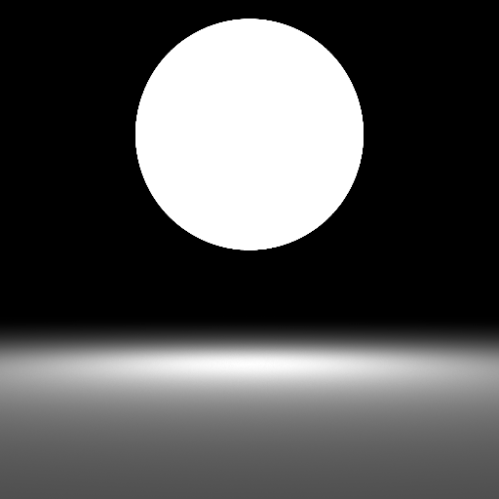
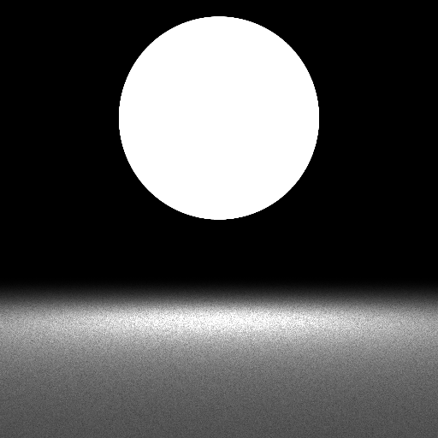
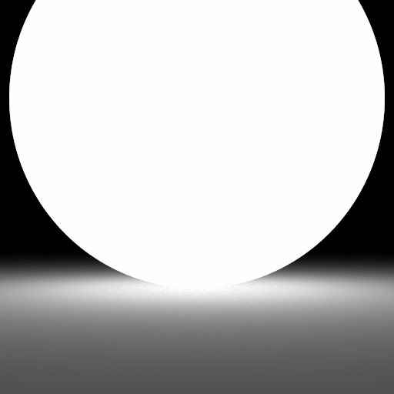
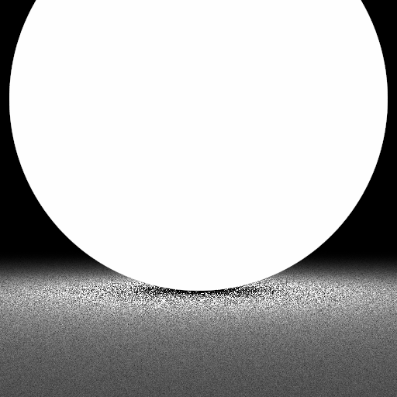
Solid angle sphere sampling left with / right without

Slide 17
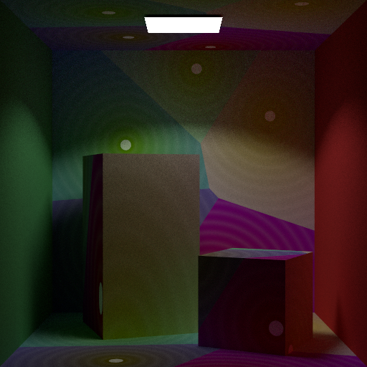
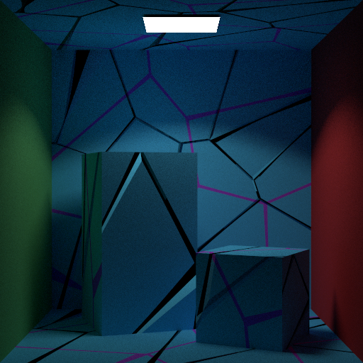
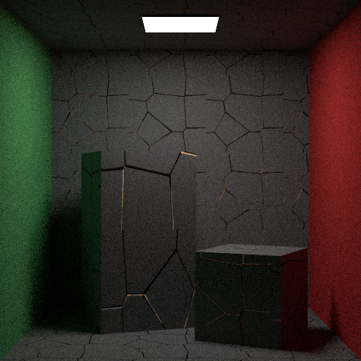
Voronoi : Texture et Normal

Slide 18
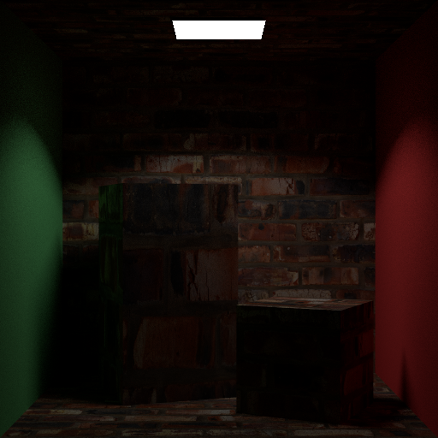
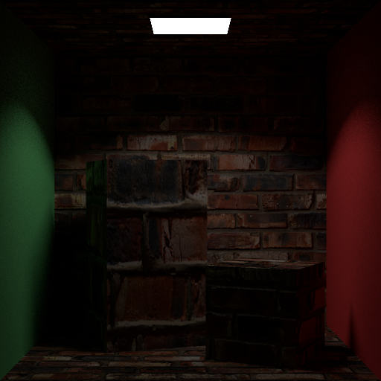
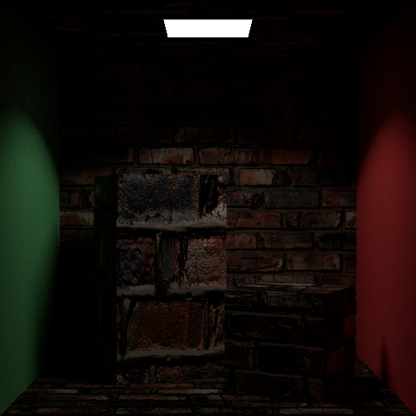

Bump Map
Diffuse
Normal
Bump
Bump + Normal

Slide 19

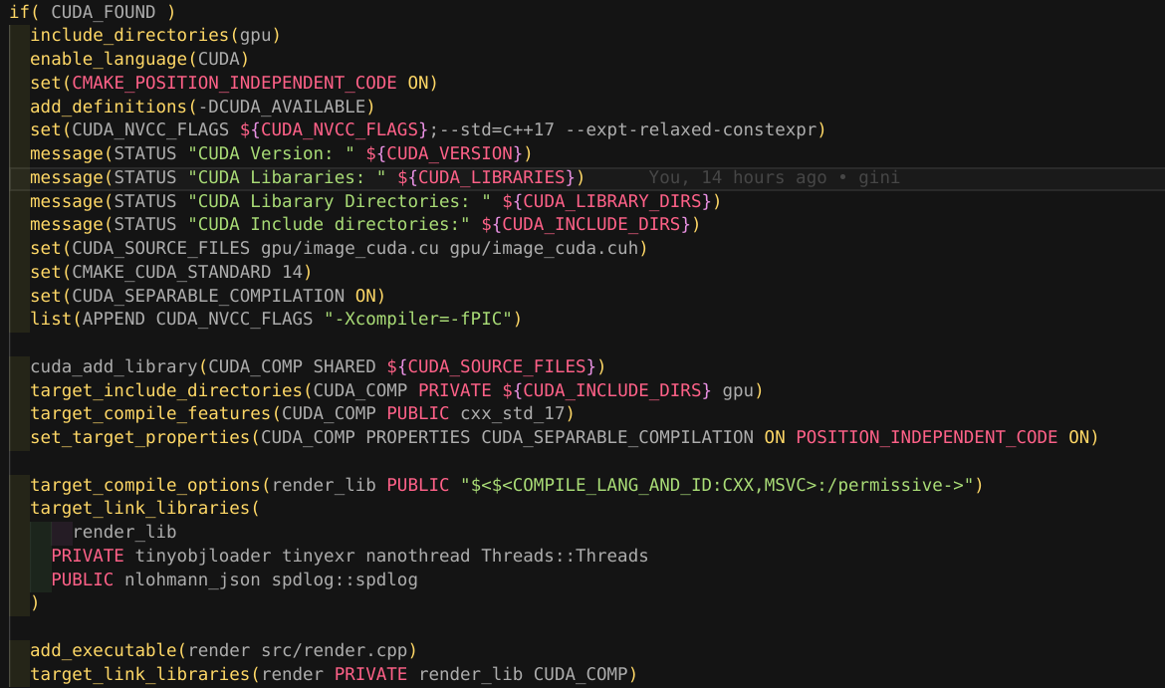
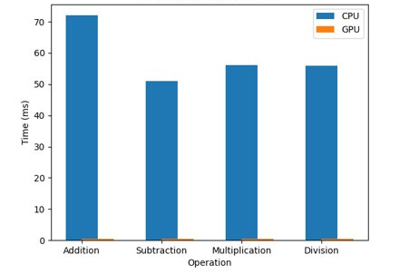



GPU Optimization
N: 10000000

Slide 20




Post Processing

Slide 21



Slide 22


Render

Slide 23


Slide 24


Slide 25





Slide 26












